Slide 1
Marco Polo Project
Team CamelCase
CIS 5040 | Dr. Arun Aryal, PhD
Raymund Delgado
Doris Gu
Kevin Ilejay
Jose Ramirez
Phiona Yogera

Slide 2

Background
CamelCase members remembered finding things around campus during first semesters
Many graduate students take classes in the evenings
Buildings and landmarks hard to find
Notes:
Phiona
Script:
An idea for the application started when Team CamelCase members discussed their first experiences when arriving in an unknown location.
A particular example of this was during our first semester at a university campus. We remembered the struggle when we had to look for specific buildings to find classes.
While the Cal State LA graduate business programs are in the evenings, this can make it even more difficult to find the buildings, the library and other spots on the campus while it is dark.
So we wanted to know more.

Slide 3

Data Gathering
Focus group
10 Interviews
Survey via Qualtrics
App development research
Notes:
Doris
Script:
Next, CamelCase had to decide if this issue was shared among students at CSULA. We then had to obtain the data to support the development of an app.
There are countless ways to gather data from students, and we used three methods
A focus group for free discussion
Personal, 1 on 1 interviews with about 4 questions
A survey of approximately 30 questions
All three methods of data collection have their strengths and weaknesses, however, we hoped to utilize the strengths of the three to gather the most comprehensive data.

Slide 4

Data Analysis - Key Takeaways
Our data supported our first hypothesis
Students tend to rely on “search first”
Students appreciate campus information but are too busy to seek it
Information appears to be scattered
Notes:
Kevin
Script:
What we concluded from all the data is that almost, if not all, students prefer convenience over methods that take numerous steps to achieve a goal. But we also found other information -
First, students often tend to search first, which is something that I and the rest of Team CamelCase find ourselves doing when loading apps
Next, students are receptive to campus news, but are just way too busy to seek out the information
And finally, information is scattered - you can get information from Cal State LA through fliers in the library, e-mails, and even word of mouth. But a student can easily miss out on that information if he/she doesn’t visit the library, doesn’t check his/her email and/or doesn’t have a strong social circle
This is when we decided on the Marco Polo Project, a project that would aim to tackle all the issues that we learned from our data gathering. We eventually decided on a smartphone application that could help solve all the problems we found to enhance the overall experience of the Cal State LA graduate student

Slide 5
Application Demonstration

Slide 6
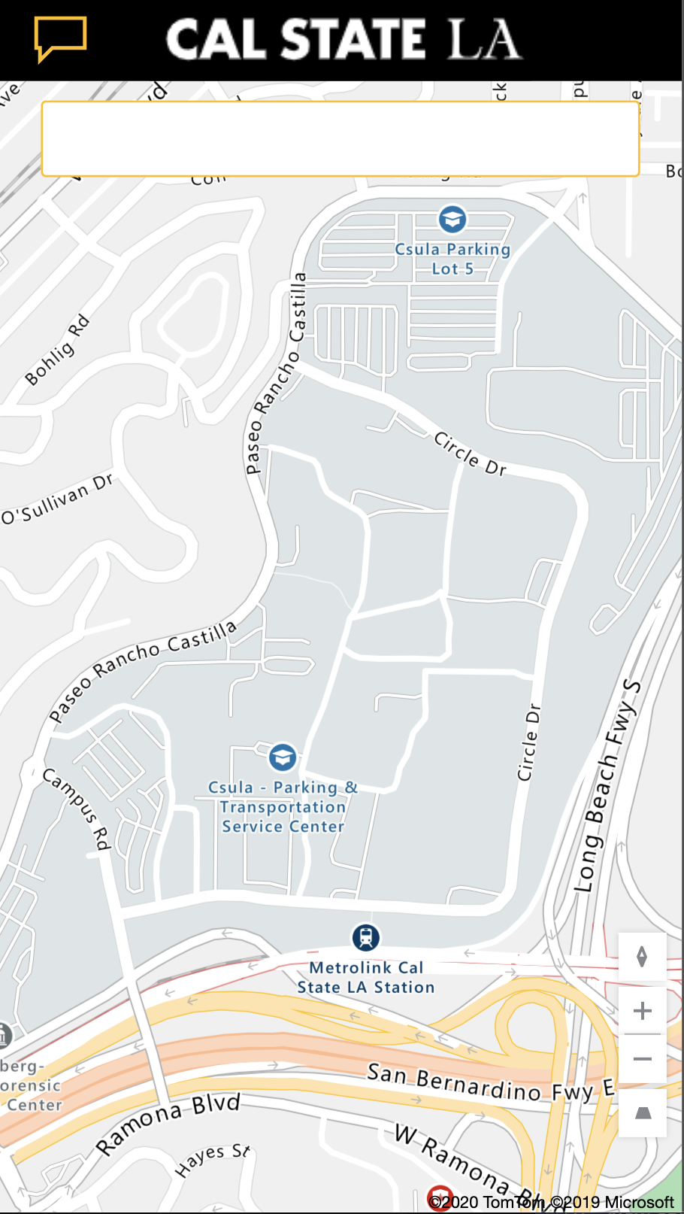
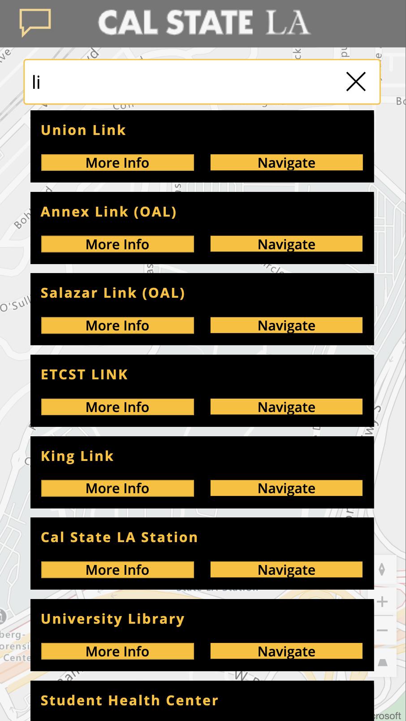
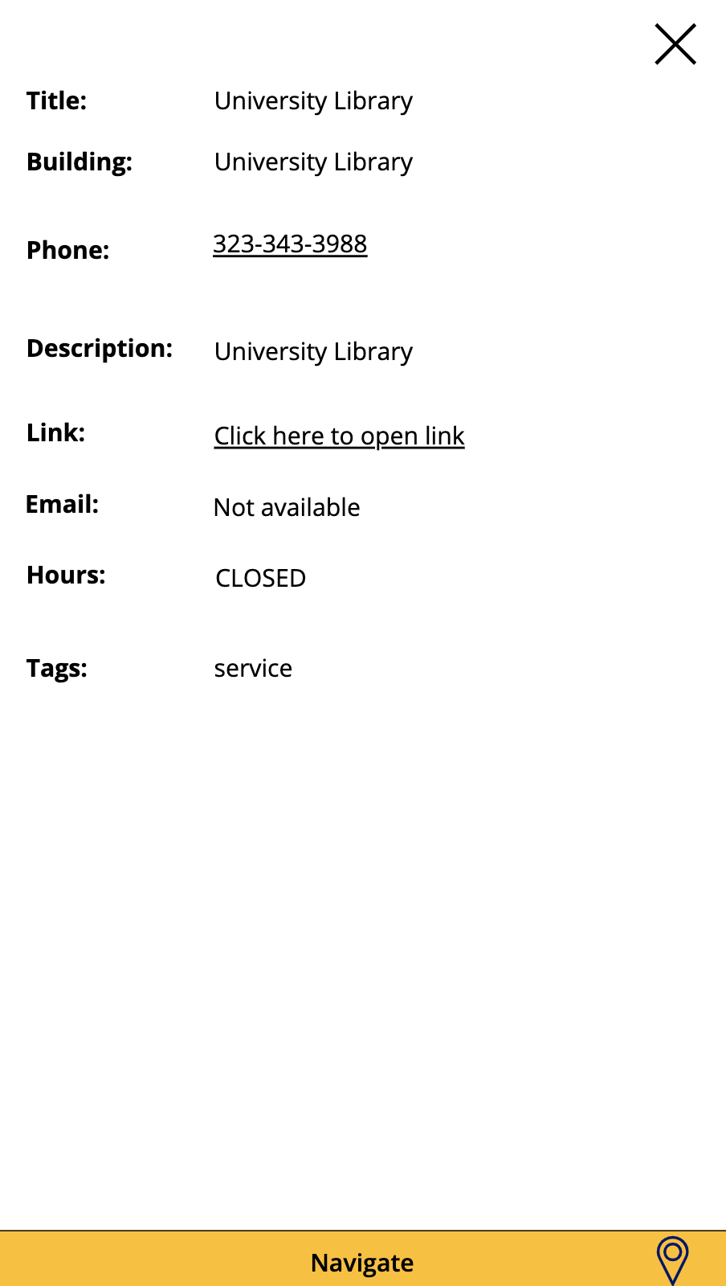
Application Design - Features
Notes:
Jose
Search > results > more info > navigate
Possible script:
Takeaways- students mentioned they like the “search first”
Keywords include buildings, departments
Navigating often had them “clicking around”
We wanted our app to give them what they needed quickly
Additionally, “more info” gives the option for key details on things they wanted to learn more about
Phone number
E-mailing the staff
Office hours
navigate
This allows reducing the amount of steps to getting the information they want
Newsfeed

Slide 7
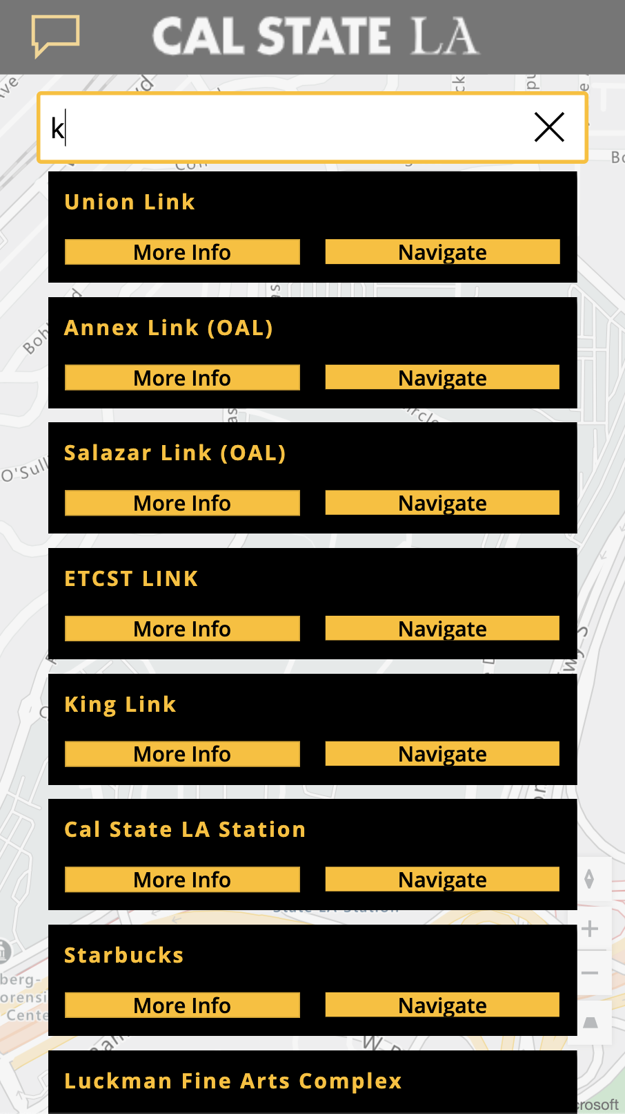
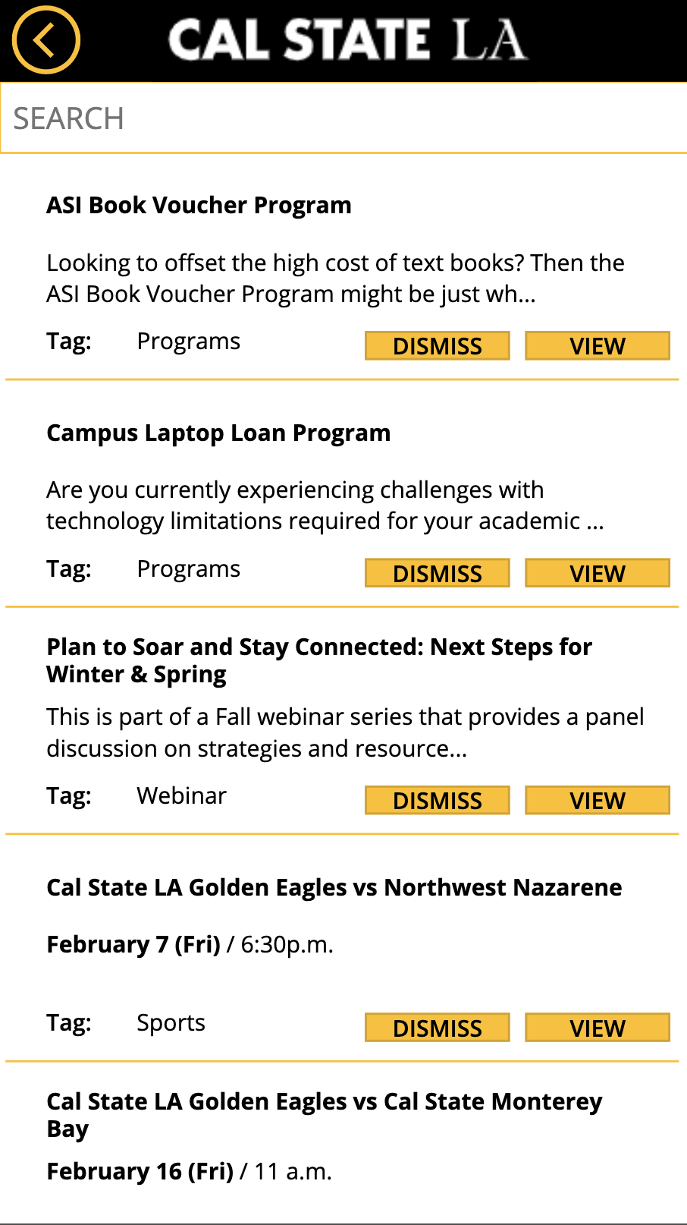
Selected Features
Login page
Home screen: Search
Results
More info
Hours of operation
E-mail
Website
Navigation/Microsoft Map
Newsfeed
Search function
View/Dismiss
Notes:
Jose
Possible Script:
Color scheme of app aligns with CSULA’s colors
Gives the feel of school spirit
Notifications feature:
Another factor we observed is that students are busy
Students don’t always have time to
A consolidated page of information that is relevant to them
Survey indicated students engaged with push notifications
The news feed will allow students to get a personalized feed with information that interests them
Goal: less steps to getting the information they want

Slide 8

Future Versions/Upgrades
Class schedule integration
Voice assistance for students with disabilities
Integrating a social media aspect
Community forum for students to interact
Notes:
Raymund
Screenshots/mockup of a future version
Notification of friends uploading
Utilizing peoplesoft API

Slide 9
App Development Concerns
Privacy Concerns
What type of data does your application record and how is it used?
How do I know my information is secure while using the app?
Class Schedule Integration
ADA Compliance
Videos of key locations and landmarks around campus
Notes:
Raymond

Slide 10
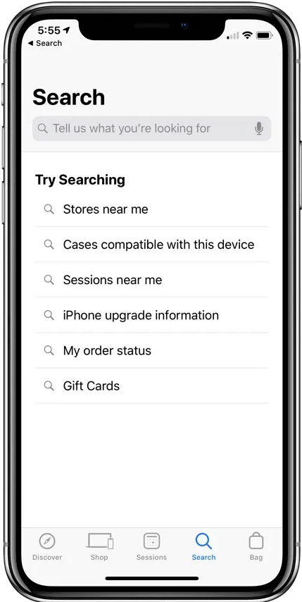
Summary
It all started with Team CamelCase
Data collection
Surveys, interviews, and a focus group
We found that
Students prefer to “search” off the bat
Receptive to campus information, but too busy to seek it
Information
Marco Polo Project
Notes:
Kevin
Script:
To just wrap everything together - this entire project began with Team CamelCase all agreeing on an issue we all experienced being graduate students.
We then explored if this issue was a common one with Cal State LA students with some methods of the Design Thinking Process
From our data, not only did we find that others students experienced the same challenges, but we also learned they had other issues finding the information they needed.
The marco polo project is an application to tackle the main challenges that Cal State LA students have, while working to minimize the amount of “steps” to find information.
Overall, this project aims to enhance the overall experience on campus by giving students the information and resources they need to succeed and achieve their goals.
And with that, we will take questions....

